Slide 1
Cyber security
Presented by – jainam singhai
Topic- session hijacking
Guided by – prof. nidhi nigam mam

Slide 2
Agenda
What is Session Hijacking?
Different ways of session hijacking .
Using Packet Sniffers
Cross Site Scripting(XSS Attack)
IP Spoofing

Slide 3
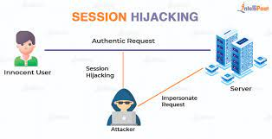
Session hijacking
TCP session hijacking is a security attack on a user session over a protected network. The most common method of session hijacking is called IP spoofing, when an attacker uses source-routed IP packets to insert commands into an active communication between two nodes on a network and disguise itself as one of the authenticated users. This type of attack is possible because authentication typically is only done at the start of a TCP session.
Another type of session hijacking is known as a man-in-the-middle attack, where the attacker, using a sniffer, can observe the communication between devices and collect the data that is transmitted.
Class | Group 1 | Group 2
Class 1 | 82 | 95
Class 2 | 76 | 88
Class 3 | 84 | 90

Slide 4
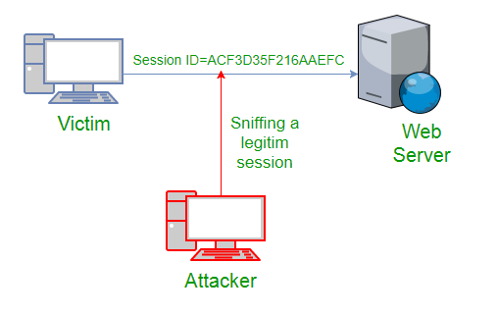
Using packet sniffers
it can be seen that attack captures the victim’s session ID to gain access to the server by using some packet sniffers.
Task 1
Task 2
Task 3

Slide 5
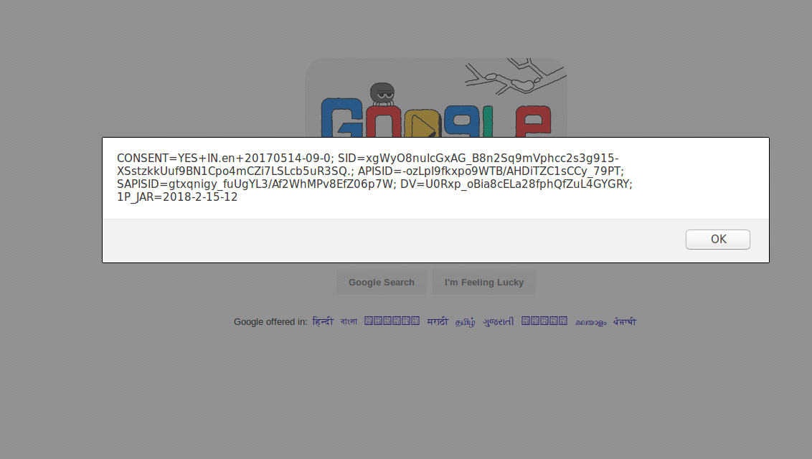
Cross Site Scripting(XSS Attack)
Attacker can also capture victim’s Session ID using XSS attack by using javascript. If an attacker sends a crafted link to the victim with the malicious JavaScript, when the victim clicks on the link, the JavaScript will run and complete the instructions made by the attacker.

Slide 6
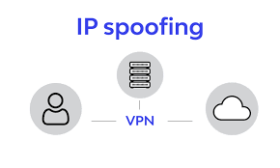
IP Spoofing
Spoofing is pretending to be someone else. This is a technique used to gain unauthorized access to the computer with an IP address of a trusted host. In implementing this technique, attacker has to obtain the IP address of the client and inject his own packets spoofed with the IP address of client into the TCP session, so as to fool the server that it is communicating with the victim i.e. the original host.

Slide 7
Thank you

